Slide 1
“A room of one’s own”
A genealogy of a phrase

Slide 2
Where did the idea come from?
Where did the phrase come from?

Slide 3
It’s a popular phrase:
A Shelf of One's Own
A Home of One's Own
A Shed of One's Own

Slide 4
Here are some more
A mind of one's own
A Death of One’s Own
Why Academics Should Blog: A College of One’s Own

Slide 5
A
And the weird ones:
A mushroom of one's own
A Rumi of One’s Own
A Broom of One’s Own

Slide 6
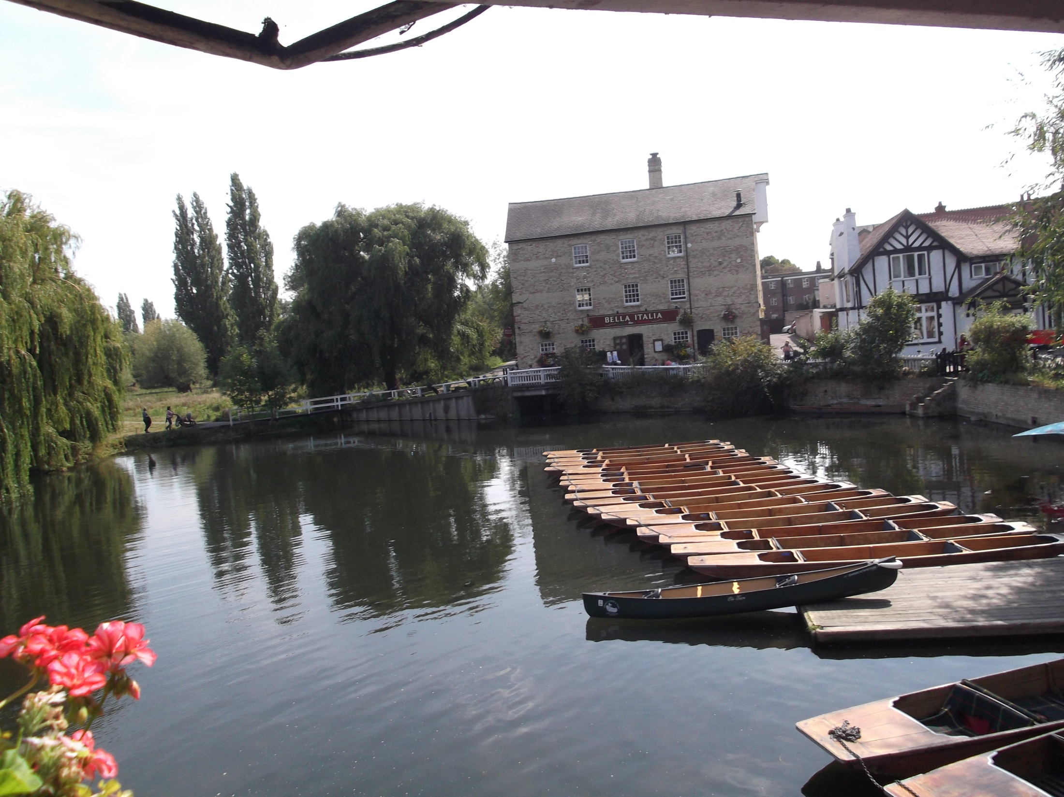
Fitzwilliam Museum lions

Slide 7
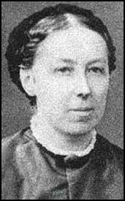

Slide 8
The condition of residence imposed by the old universities must exclude women until there are able, by means of a college of their own, to offer guarantees as to instruction and discipline similar to those which are required at Oxford and Cambridge
Emily Davies

Slide 9
Every student has a room to herself, in which she can be as much or as little alone as she likes, & she has also the opportunity of friendly companionship in work & play.
Miss Nightingale has said, in her forcible way, that she has never known persons who exposed themselves (20) for years to constant interruption, who did not muddle their intellects by it at last. This is putting it rather strongly.

Slide 10
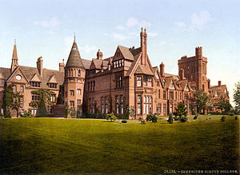

Slide 11
From Emily Davies and Girton College 1927
“Most of the students have both a bedroom and a sitting-room, and the dimensions of the rooms and the corridors show no enlargement of scale with the passage of time. It was and still is unusual in a women’s college for students to have both sitting-room and bedroom.” 312
“Privacy was the one luxury which Miss Davies desired for the students; and in her eyes it was not a luxury—she despised luxuries—but a necessity” (312)

Slide 12
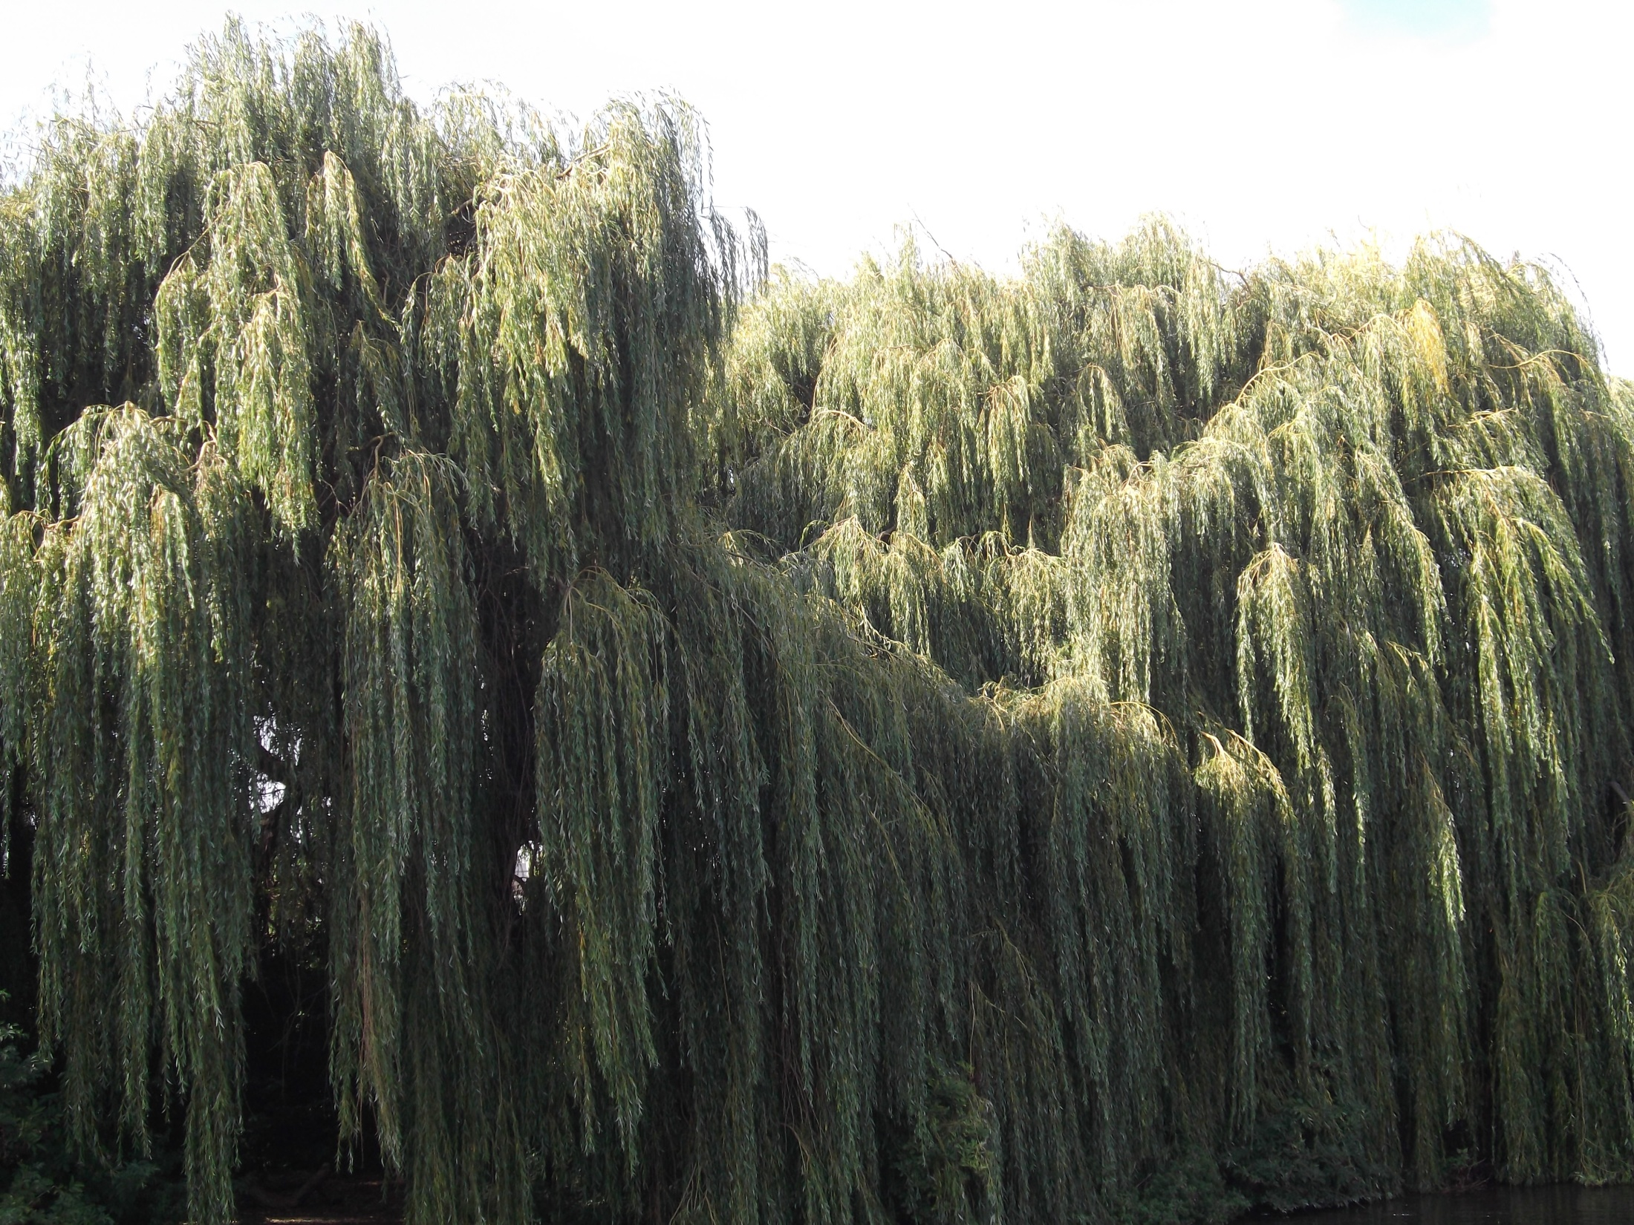

Slide 13
About the lectures:
I blandly told them to drink wine & have a room of their own (Diary 3 200)

Slide 14
From the manuscript “Women and Fiction” at the Fitzwilliam
<It is> absolutely essential then necessary that they should have money, & a room to themselves” I said aloud (Chapter One—this is the fish!)

Slide 15
And my belief is, that if the habit of freedom, of so <you> we had say five hundred a year <say> each, & a rooms to ourselves (conclusion)
Final version:
And have five hundred a year each of us and rooms of our own

Slide 16
From the Monks’ House Papers:
I should never come to any conclusion. I should only come express an opinion-that one <she> must have money & a room of one’s own: and that she must have 500 a year & a room with a lock on the door>

Slide 17
Notes: Conclusion—money & a room of <your own>
What is the importance of writing? Reality. The rest of life is humbug. . . . But more is needed. Aunts must be killed.

Slide 18
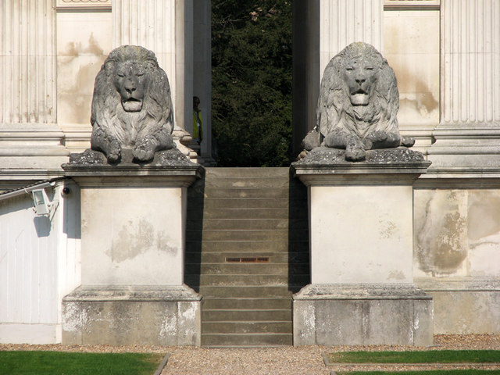
Fitzwilliam Museum lions

Slide 19
From the manuscript “Women and Fiction” at the Fitzwilliam
<It is> absolutely essential then necessary that they should have money, & a room to themselves” I said aloud

Slide 20
. Davies wants a private space for scholarly reflection, enabling women to succeed at Cambridge and reach the same academic goals as men. Woolf describes a room outside of any institution, a room in which the writer is free to think for herself, not study for an exam. A room in which to defy convention, and defeat the angel in the house.

Slide 21
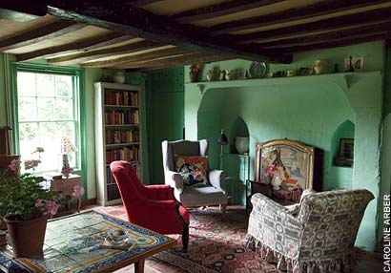

Slide 22
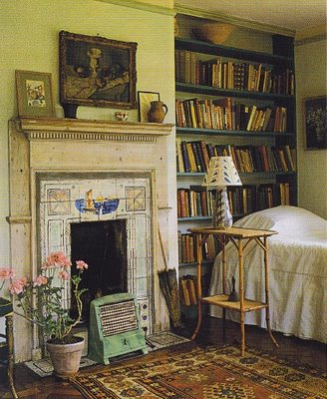

Slide 23
From the Writer’s Diary December 18, 1928
we have sold over 6,000 copies <of Orlando>; and sales are still amazingly brisk.. . . Will they stop or go on? Anyhow my room is secure. For the first time since I married 1912-1928—16 years, I have been spending money.

