Slide 1
Why is this domain project valuable and exciting?

Slide 2
30 years ago, only 8 percent of 13-year-olds and 9 percent of 17-year-olds said that they “hardly ever” or never read for pleasure. Today, 22 percent of 13-year-olds and 27 percent of 17-year-olds say that they hardly ever or never read for pleasure. –Common Media

Slide 3
The report suggests the average American consumes 34 gigabytes of content and 100,000 words of information in a single day. (Leo Tolstoy’s “War and Peace” is only 460,000 words long.)

Slide 4
This doesn’t mean we read 100,000 words a day — it means that 100,000 words cross our eyes and ears in a single 24-hour period.
–Nick Bilten

Slide 5
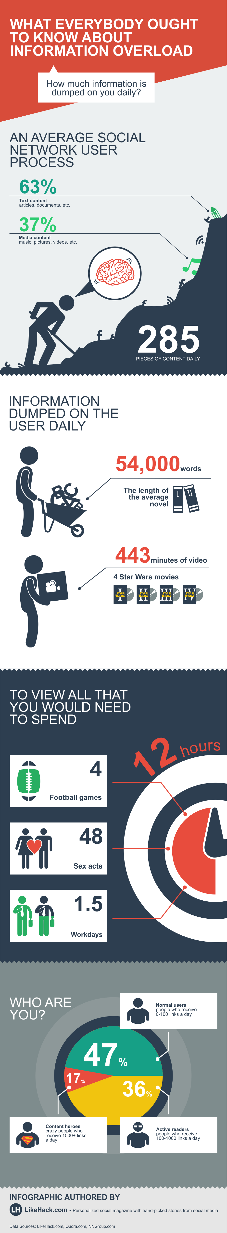

Slide 6
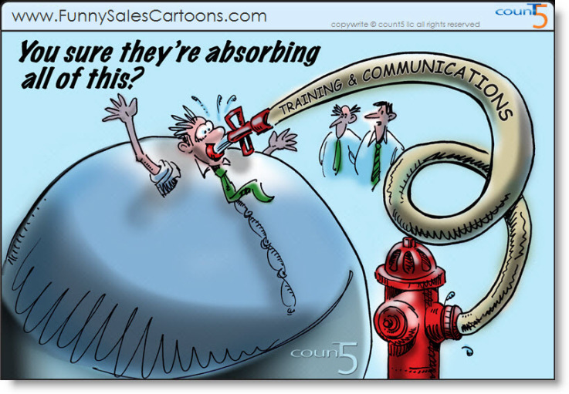

Slide 7
And then there’s writing
Average mobile phone user will send 2 million words via text in their lifetime

Slide 8
Average mobile phone user will send 2 million words via text in their lifetime
Facebook, twitter, blogging—they’re writing all the time!

